Slide 1
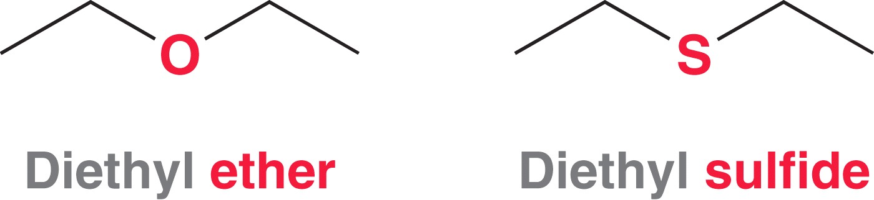
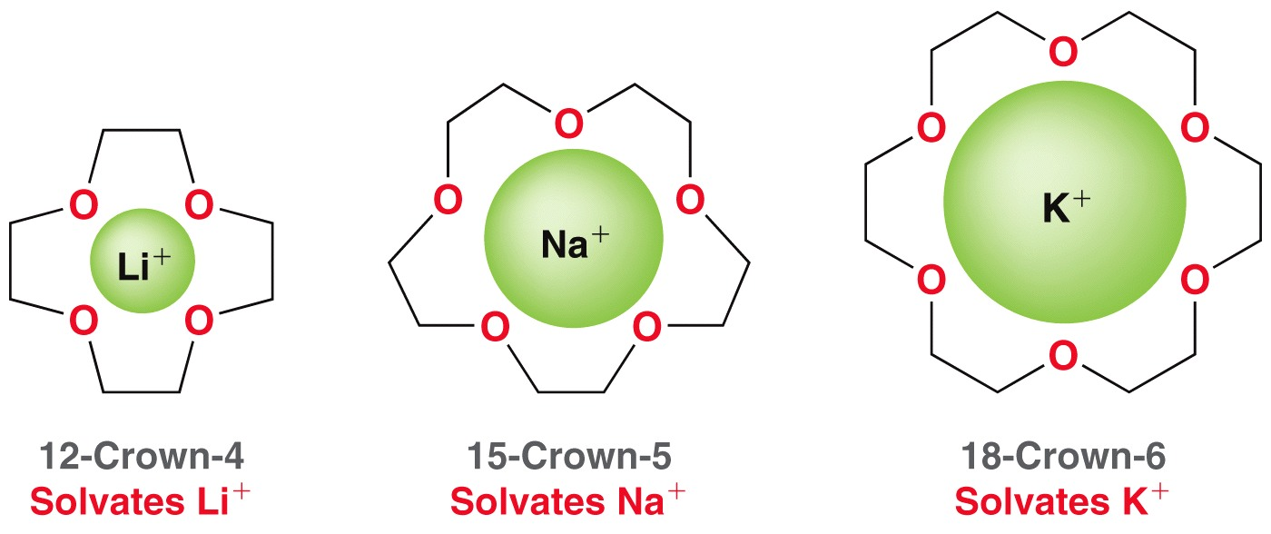
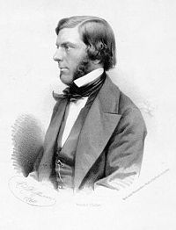
SECTION III (CHAP. 14)
ETHERS, EPOXIDES THIOLS AND SULFIDES
Alexander William Williamson (1 May 1824 – 6 May 1904) was an English chemist of Scottish descent who developed the Williamson ether synthesis.

Slide 2
FUNDAMENTAL CONCEPTS
Nomenclature of ethers
Synthesis of ethers
Cleavage of ethers
Synthesis and reactivity of epoxides
Nomenclature of thiols and sulfides

Slide 3
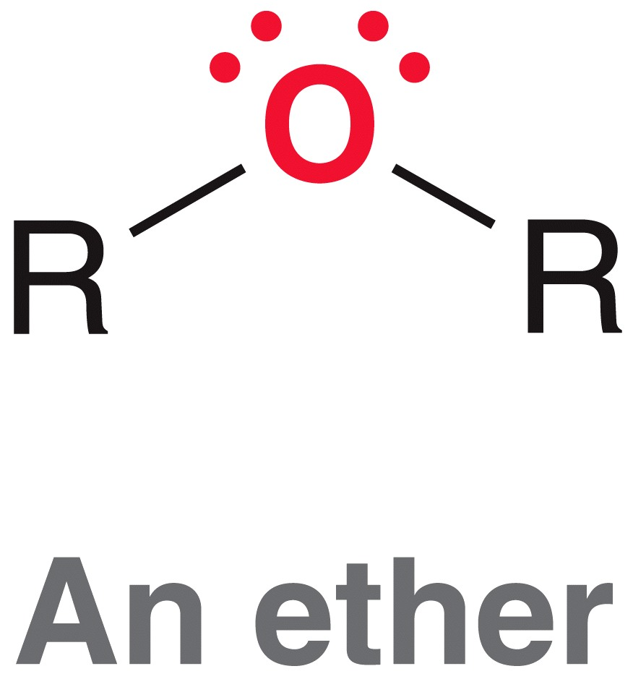
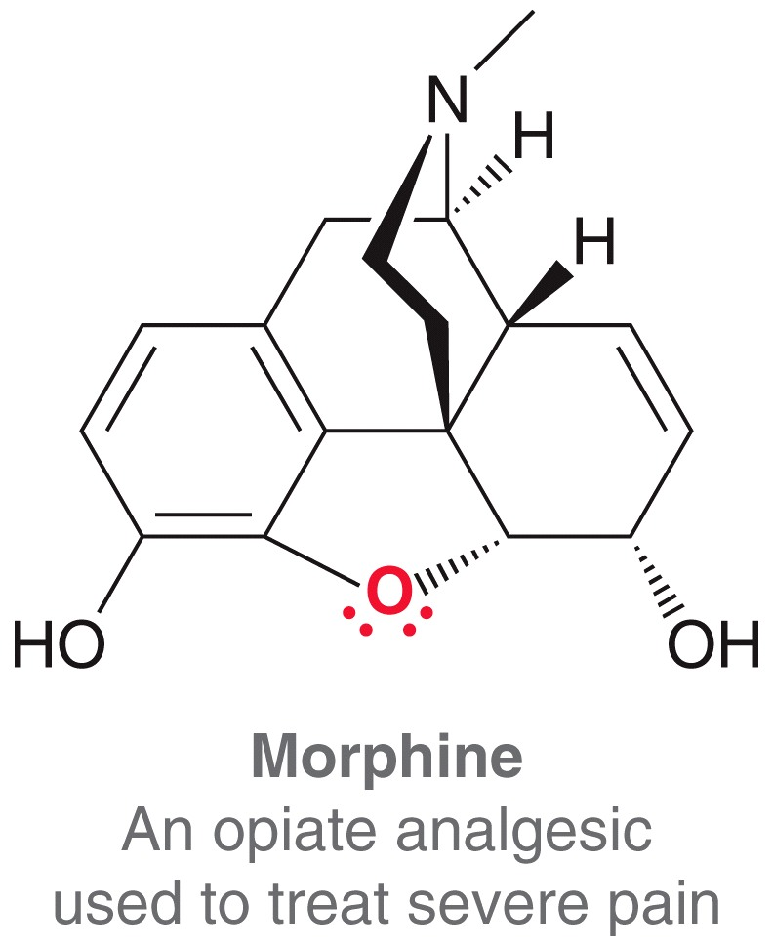
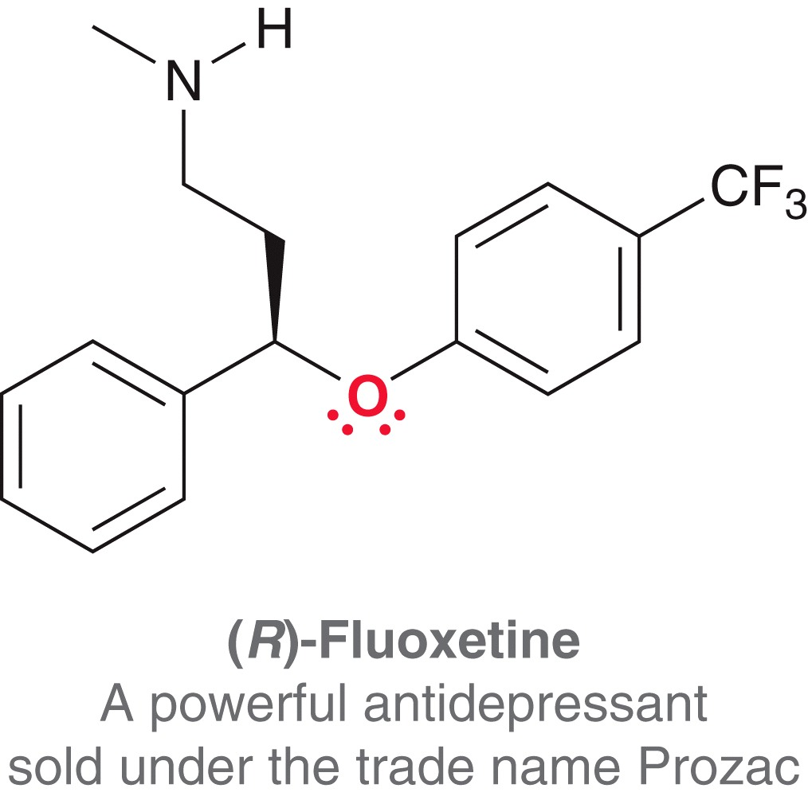
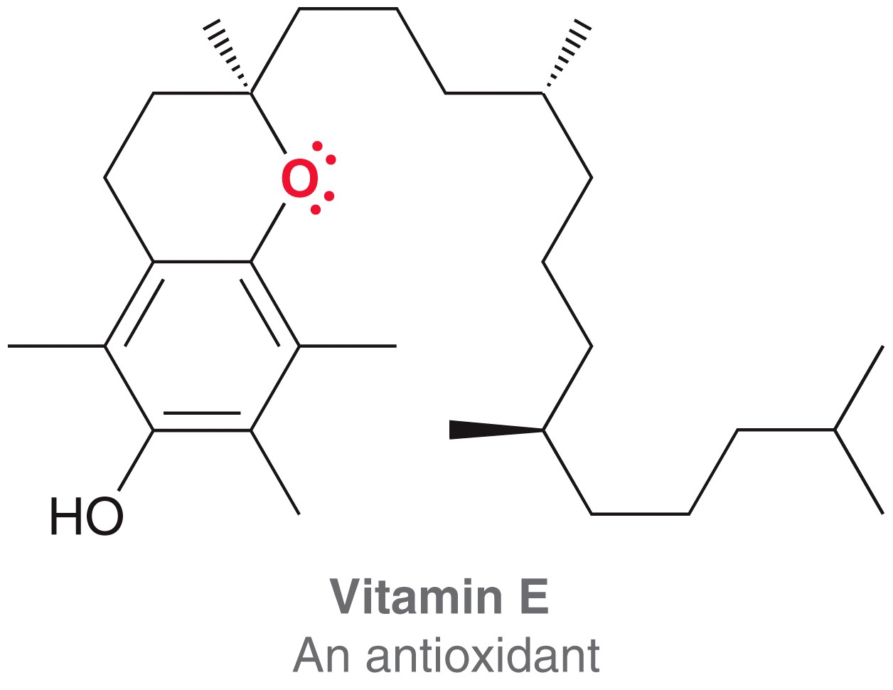
ETHERS
Structure and Physical Properties
An ether group includes an oxygen atom that is bonded to TWO –R groups, of general formula R-O-R’ where R and R’ may be alkyl or aryl groups. R and R’ are the same in symmetrical ethers and different in unsymmetrical ethers.

Slide 4
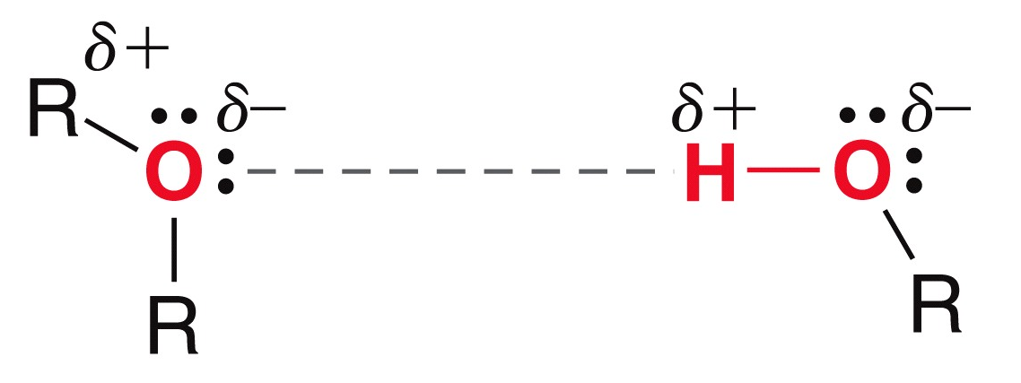
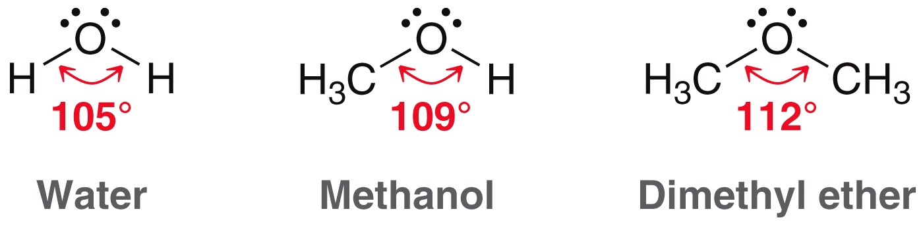
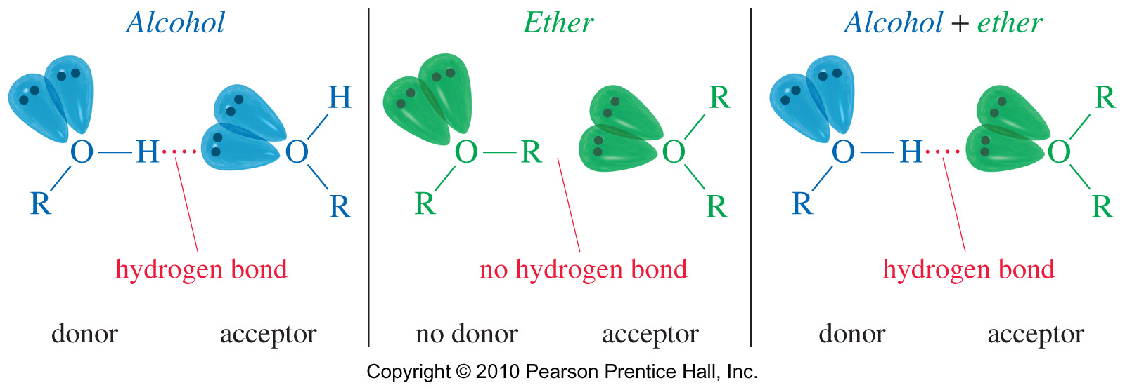
ETHERS
Structure and Physical Properties
The bond angle in ethers is very similar to that found in water and in alcohols.
Although pure ethers have no hydroxyl groups to engage in hydrogen bonding, they are hydrogen bond acceptors.

Slide 5
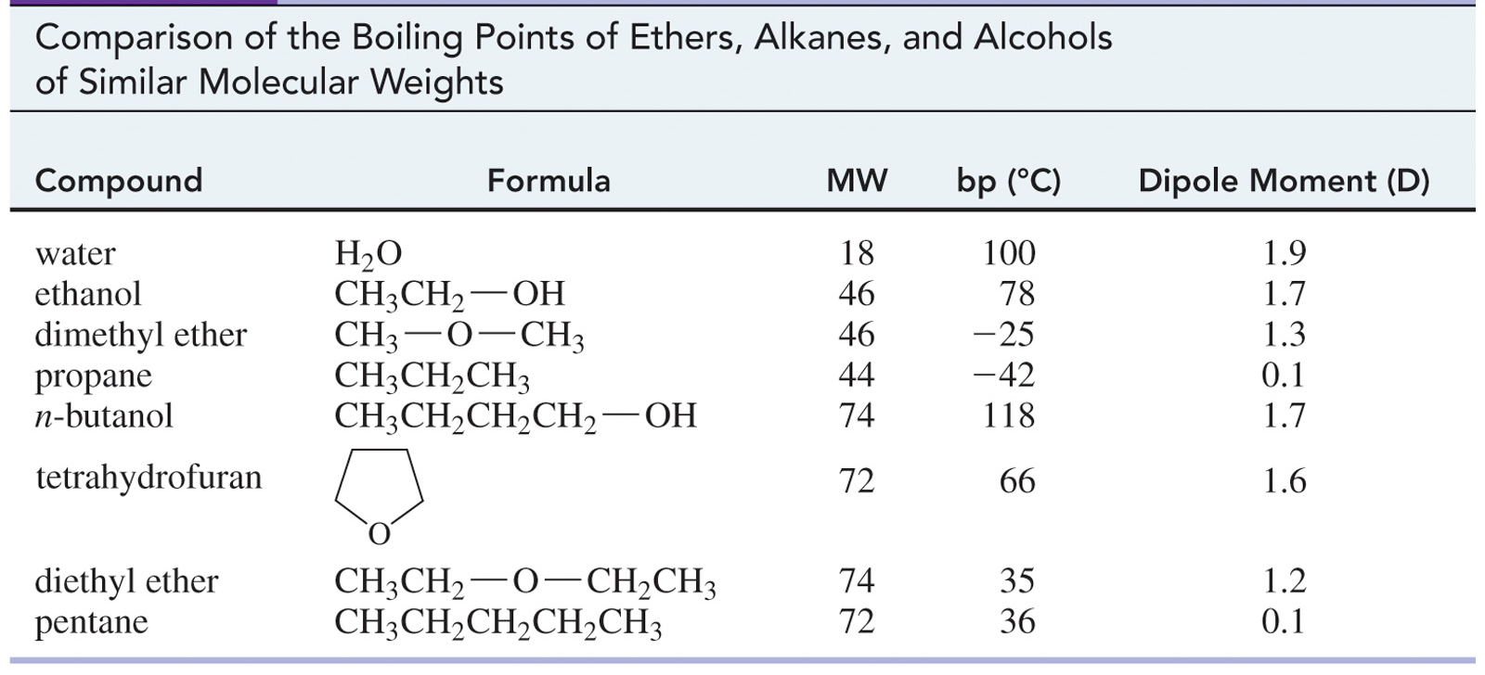
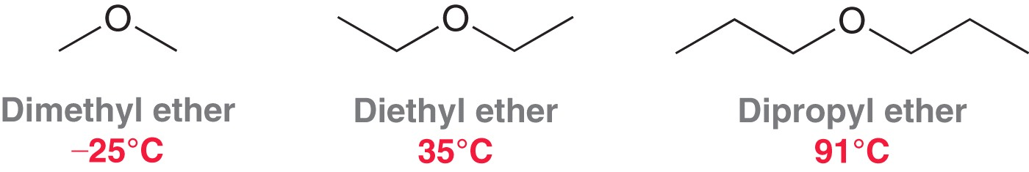
ETHERS
Structure and Physical Properties
Their boiling points are similar to that of alkanes of comparable molecular weight

Slide 6
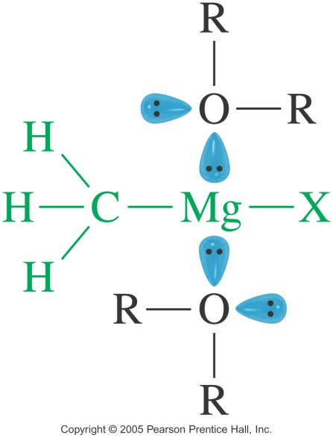
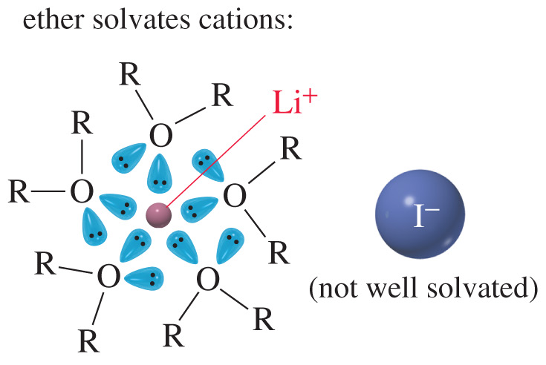
ETHERS
Structure and Physical Properties
Ethers are ideal solvent for many organic reactions
Ethers dissolve a wide range of polar and non-polar substances
Nonpolar solutes dissolve better in ether than in alcohol.
Ether has large dipole moment, so polar solutes also dissolve.
Ethers solvate cations.
Ethers do not react with strong bases
Their relatively low boiling points simplify their evaporation
Metal atoms with a full or partial positive charge can be stabilized by ether solvents, as a result, ethers are generally used as the solvent in the Grignard reaction.

Slide 7
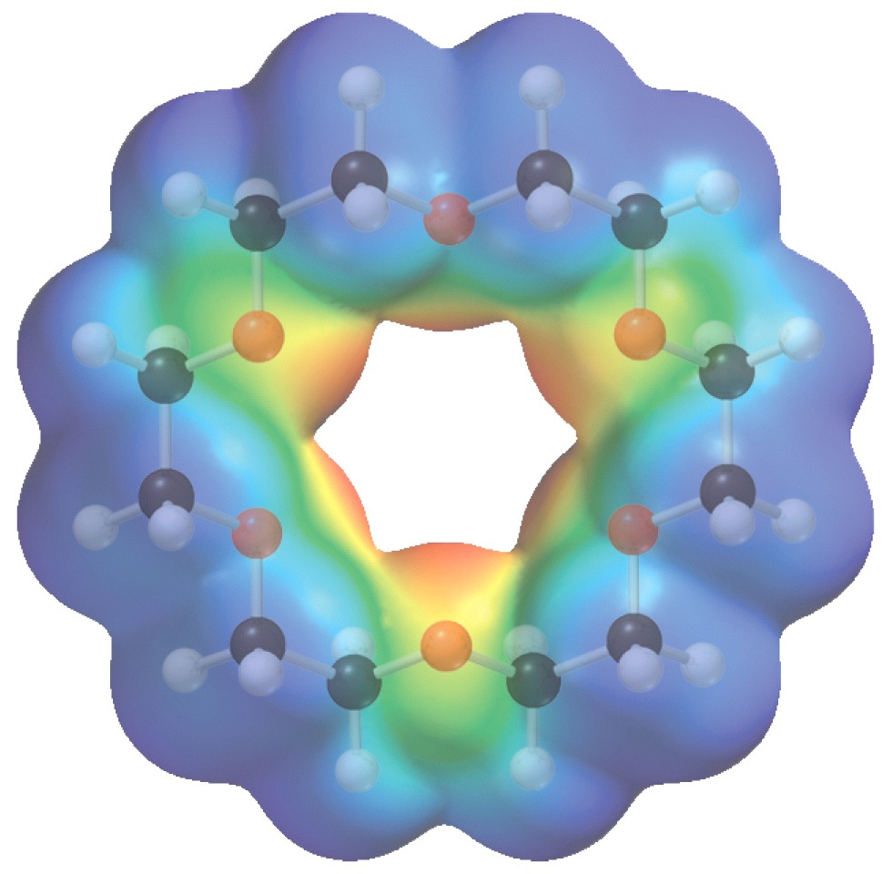
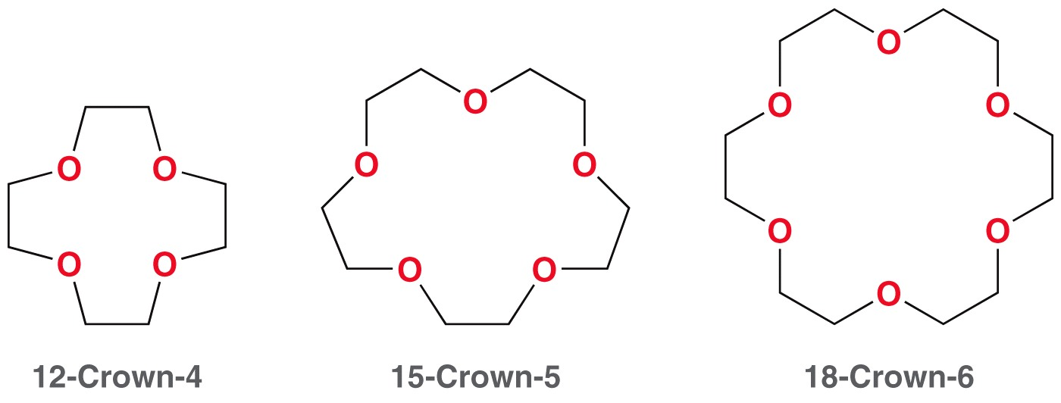
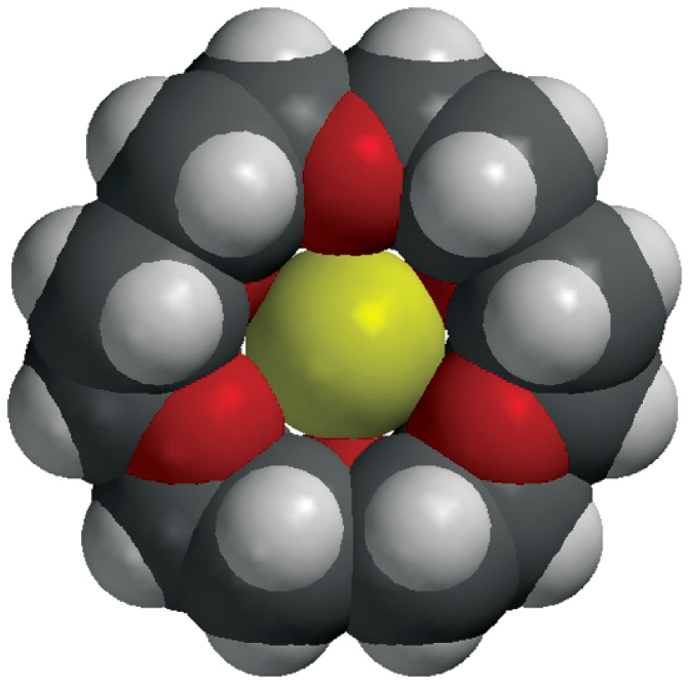
ETHERS
Structure and Physical Properties
Crown ethers have been shown to form especially strong attractions to metal atoms

Slide 8
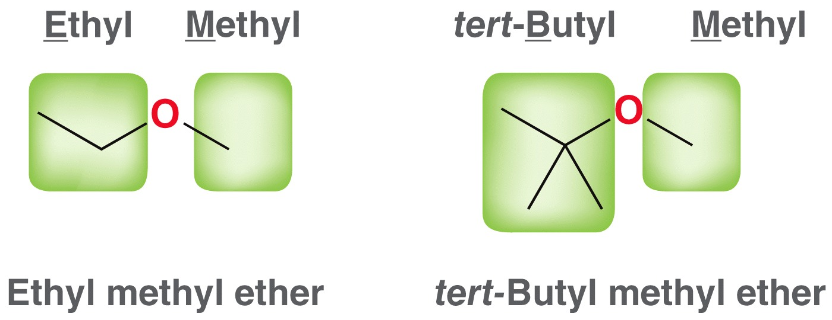
ETHERS
Common Names of Ethers
Ethers are commonly called Alkyl alkyl ether
In the current rule the alkyl groups should be in alphabetical order
However the old rule, which named the groups in order of increasing complexity, is still in use
Symmetrical ether are called dialkyl ether or just alkyl ether

Slide 9
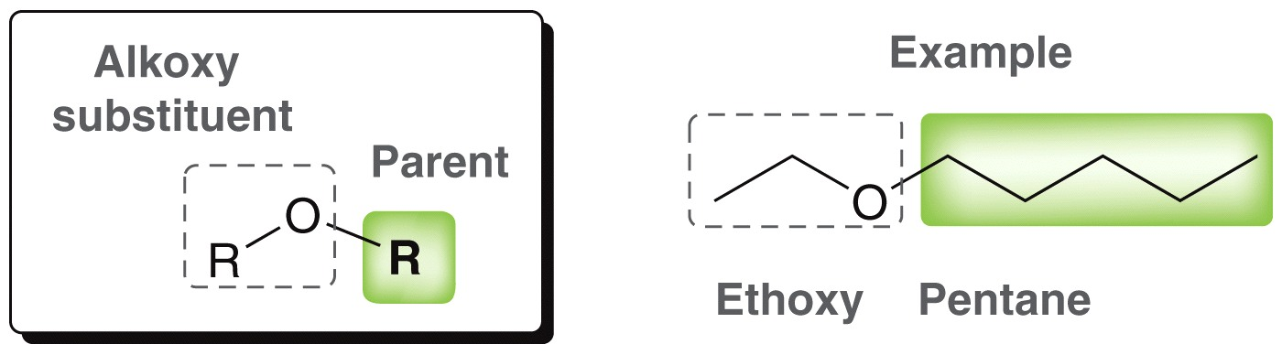
ETHERS
IUPAC Names (Alkoxy Alkane)
The IUPAC names use the more complex alkyl group as the root, and the rest of the ether as an alkoxy group.
Cyclic Ethers

Slide 10
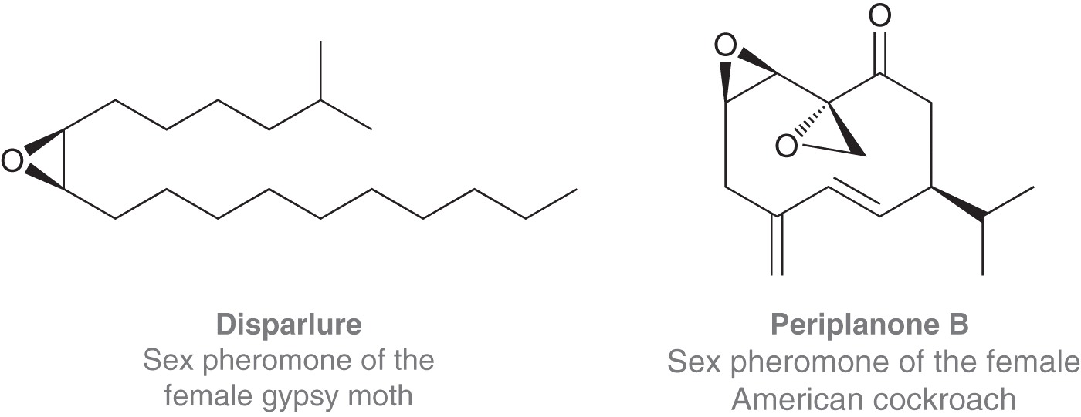
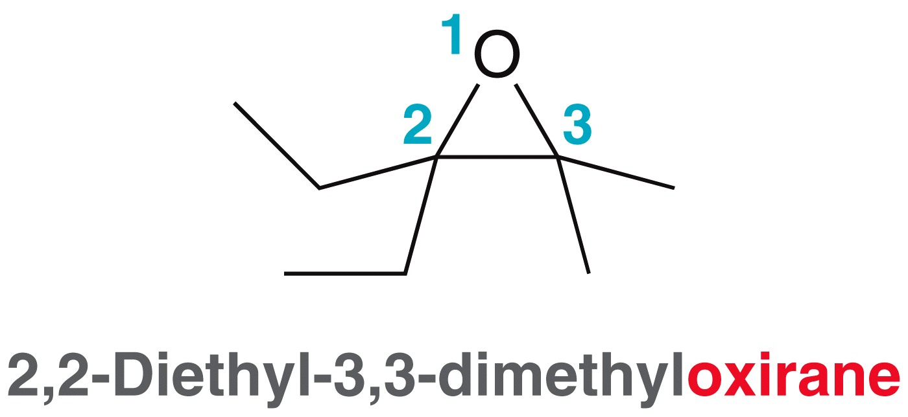
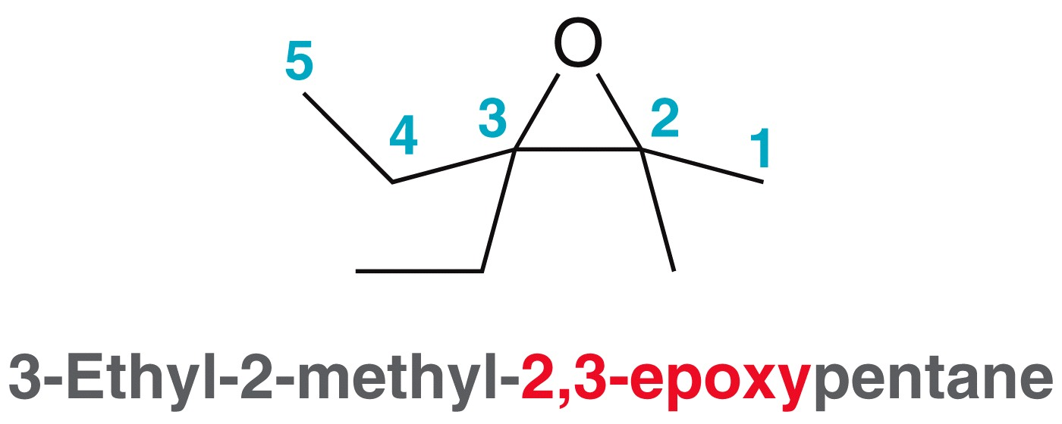
ETHERS
Epoxides

Slide 11
ETHERS
Examples: Name the following compounds
Practice 14.1 to 14.3 P. 636, 14.12, 14.13 P. 648
Naming Priority
Acids
Acid halides
Esters
Amides
Nitriles
Aldehydes
Ketones
Alcohols
Amines
Alkenes
Alkynes
Alkanes
Ethers
Halides

Slide 12
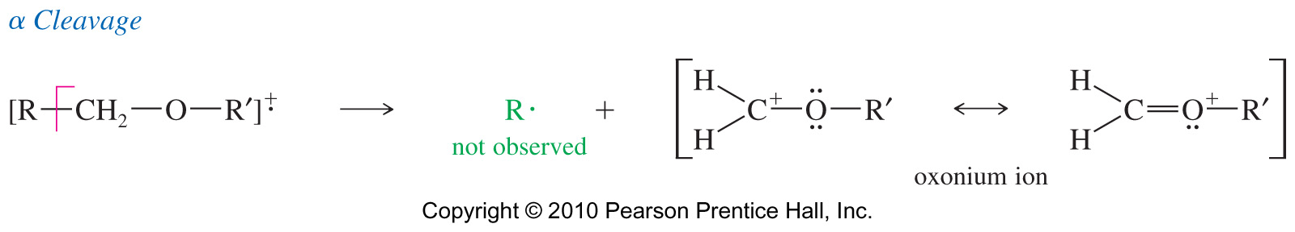
SPECTROSCOPY OF ETHERS
¹H-NMR
¹H-C-O signal between δ3.5-δ4; ¹³C-O signal between δ65-δ90
IR of Ethers
The C—O stretch is in the fingerprint region around 1000–1200 cm⁻¹.
Many other compounds such as esters and alcohols have the C—O stretch.
If the IR spectrum has the C—O stretch but does not have a C═O or an OH stretch, then the compound is most likely an ether.
MS Spectrometry of Ethers
Main fragmentation is the α-cleavage to form the resonance-stabilized oxonium ion.
Either alkyl group can be cleaved this way.

Slide 13
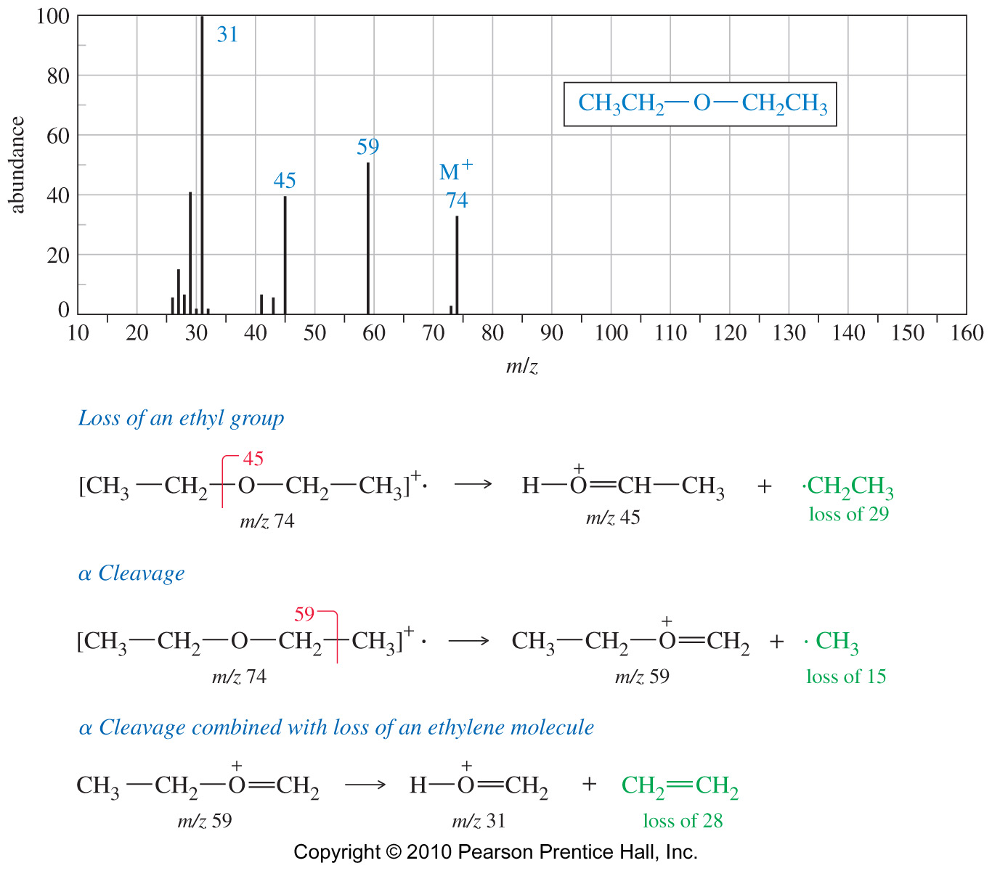
SPECTROSCOPY OF ETHERS
MS Spectra of Diethyl Ether

Slide 14
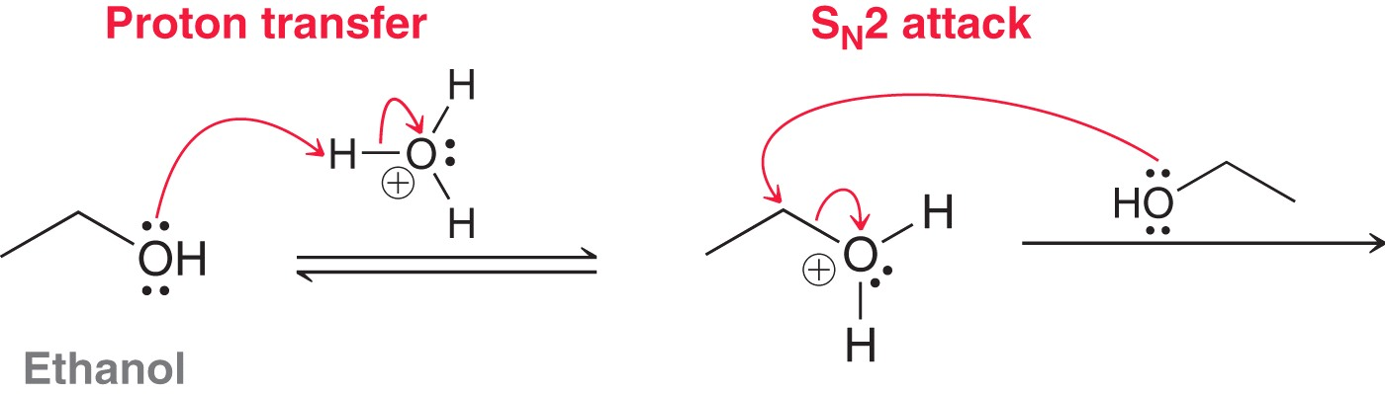
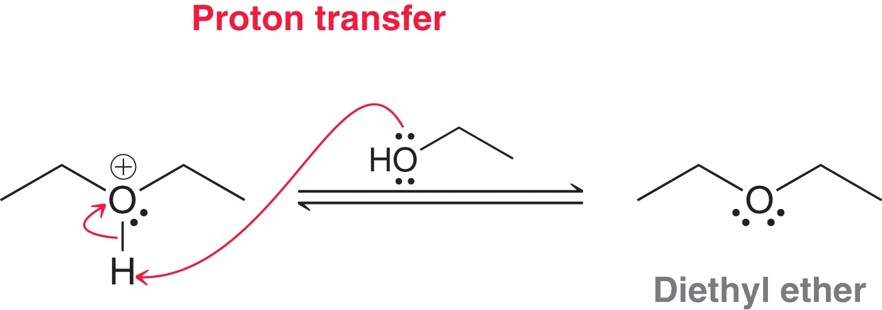
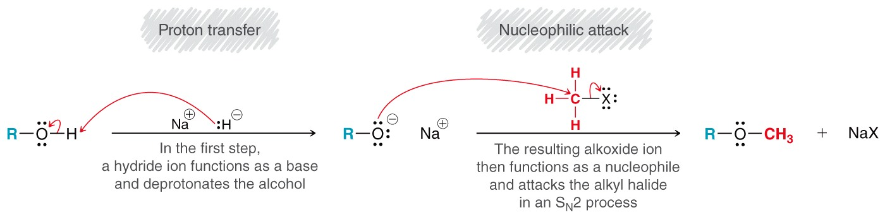
SYNTHESIS OF ETHERS
Diethyl ether is prepared industrially by the acid-catalyzed dehydration of ethanol
The Williamson Ether Synthesis
The Williamson ether synthesis is the most reliable and versatile ether synthesis. It involves S_{N}2 attack of primary alkyl bromide (or tosylate) by an alkoxide ion

Slide 15
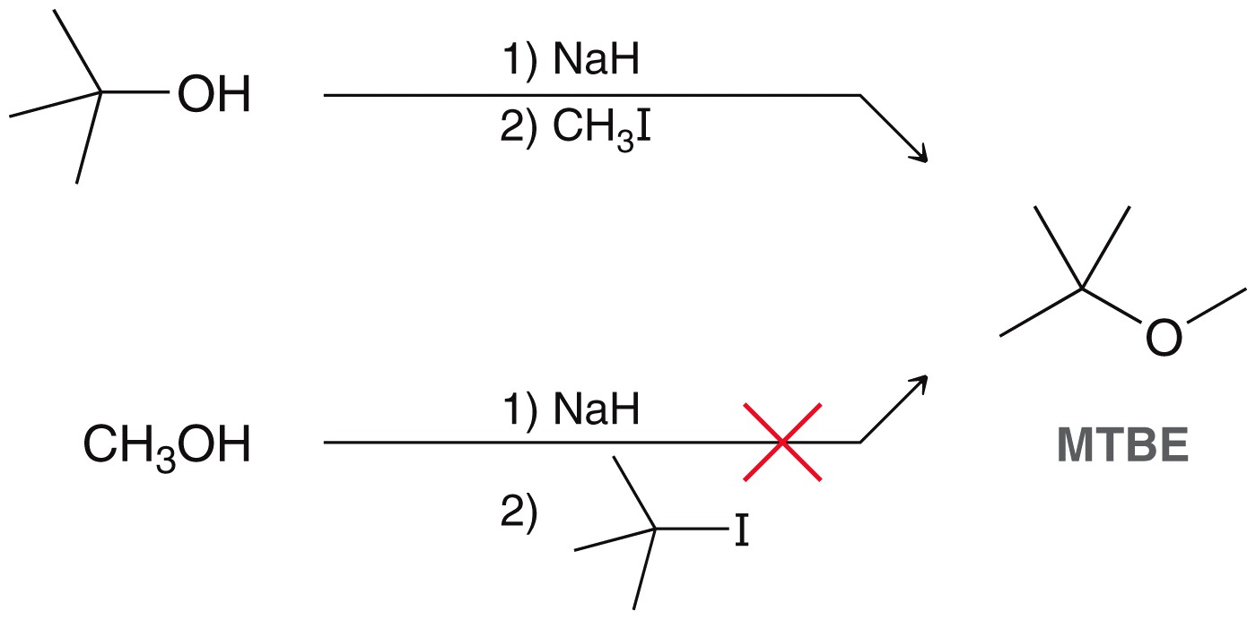
SYNTHESIS OF ETHERS
The Williamson Ether Synthesis
The Williamson ether synthesis is a viable approach for many asymmetrical ethers.
Practice 14.5 P. 643

Slide 16
SYNTHESIS OF ETHERS
The Williamson Ether Synthesis
Phenoxide ions can also be used in the Williamson synthesis. In this case, phenyl halides or tosylates cannot be used.

Slide 17
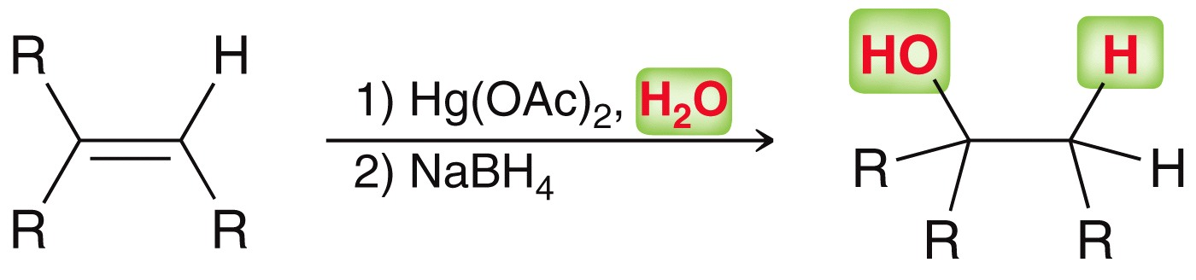
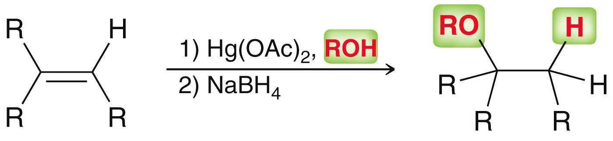
SYNTHESIS OF ETHERS
Alkoxymercuration-Demercuration
Alkoxymercuration-Demercuration
The reaction uses mercuric acetate with an alcohol to add RO-H to a double bond and form the Markovnikov product

Slide 18
SYNTHESIS OF ETHERS
Alkoxymercuration-Demercuration
Practice 14.8 P. 644
Examples: Predict the major product for the following reaction

Slide 19
THE CLEAVAGE OF ETHERS
Unlike alcohols, ethers are not commonly used as synthetic intermediates because they do not undergo many reactions. Even so, ethers do undergo a limited number of characteristic reactions:
Ethers are unreactive toward bases, but protonated ethers can undergo substitution reactions with strong acids. In this case, the alcohol leaving group is replaced by a halide.
Reactivity: HI > HBr >> HCl
Mechanism for Cleavage

Slide 20
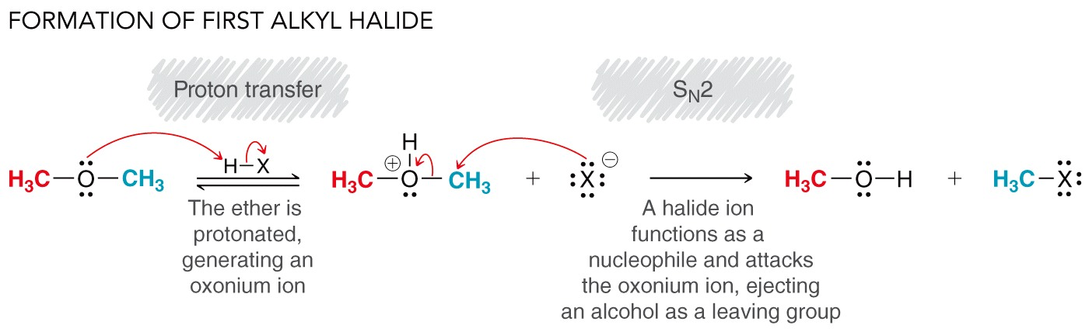
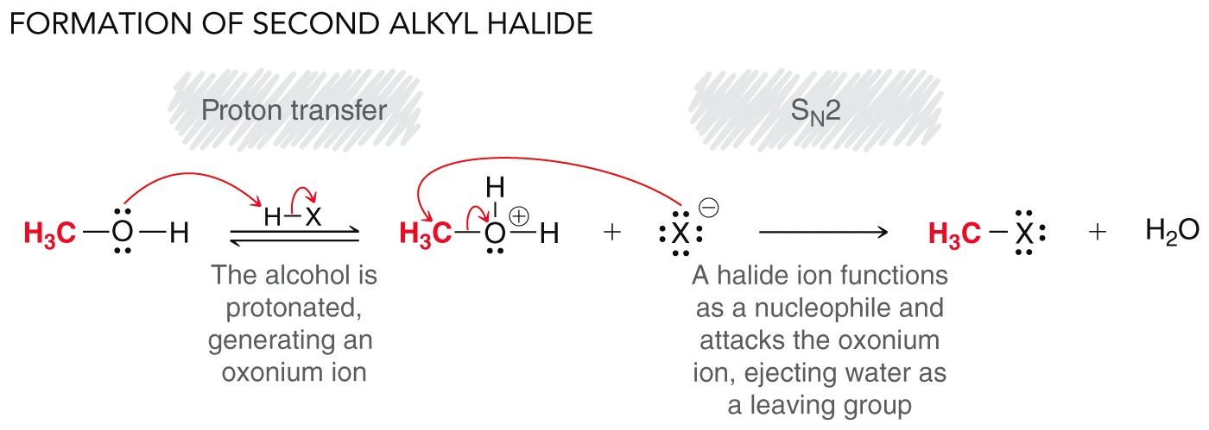
THE CLEAVAGE OF ETHERS
Practice 14.11 P. 645

Slide 21
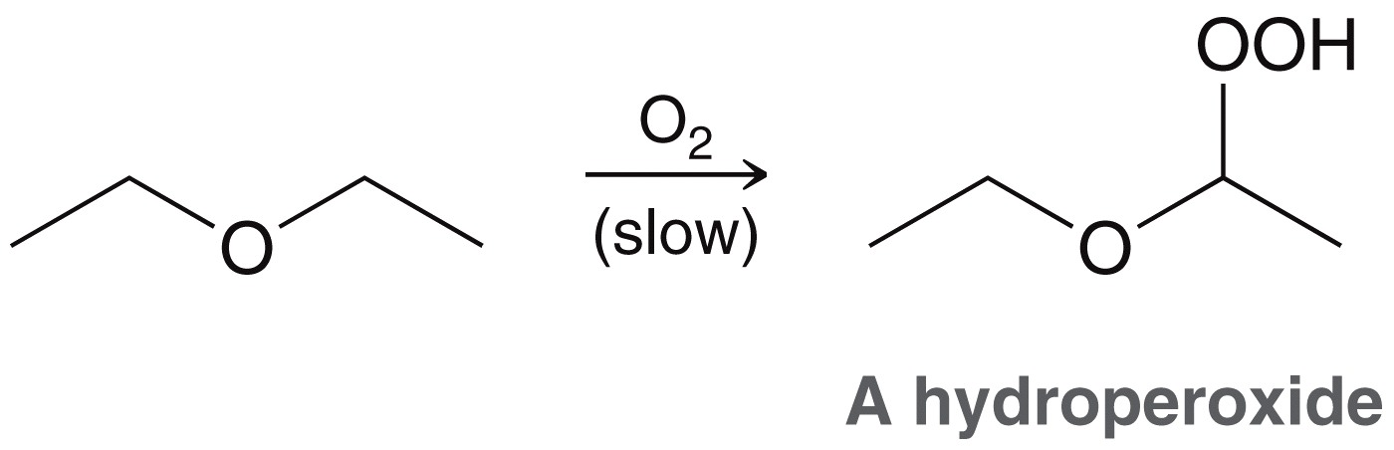
THE CLEAVAGE OF ETHERS
Phenyl Ether Cleavage
Phenol cannot react further to become halide
CAUTION!!! (Autoxidation of ethers)
In the presence of atmospheric oxygen, ethers slowly oxidize to hydroperoxides and dialkyl peroxides.
Both are highly explosive.
So, do not distill ether to dryness. Store it in full bottles with tight caps

Slide 22
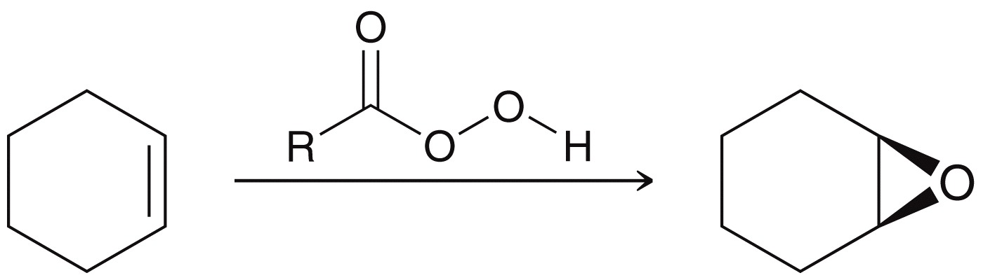
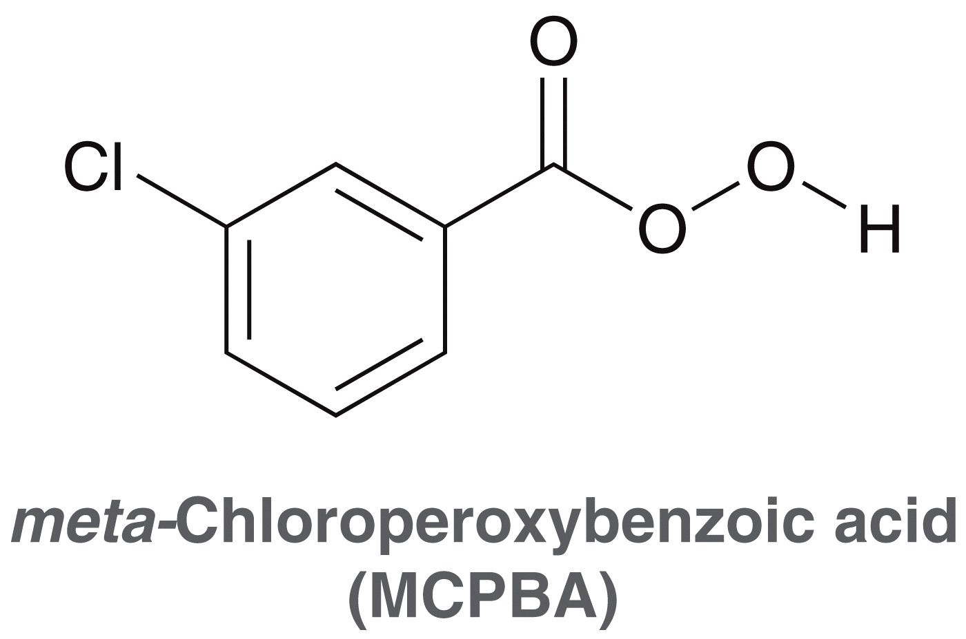
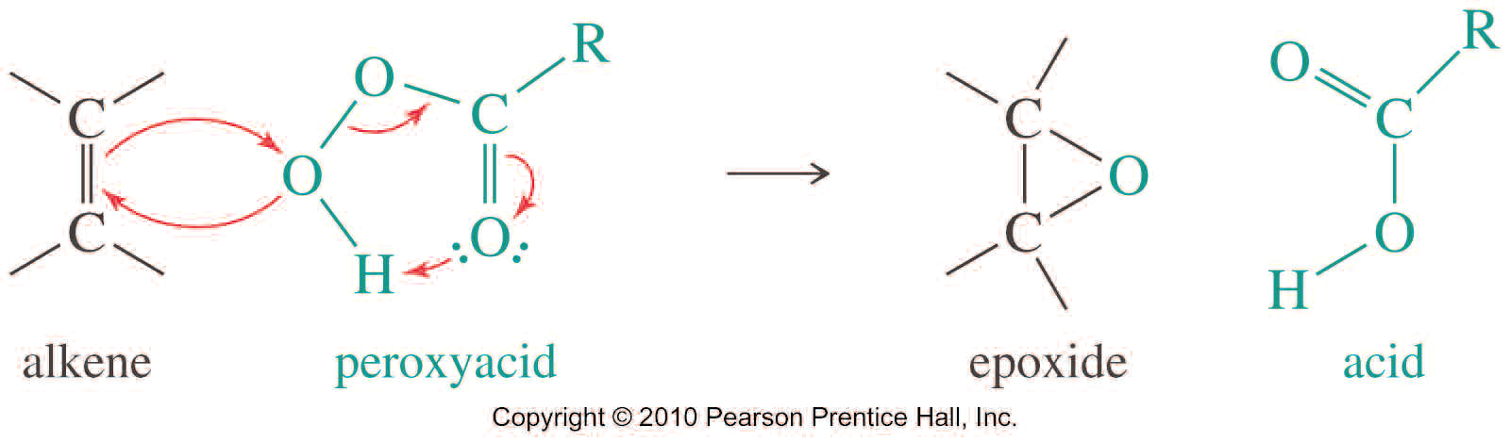
SYNTHESIS OF EPOXIDES
Peroxyacid epoxidation
Because of its desirable solubility properties, meta-chloroperoxybenzoic acid (MCPBA) is often used for these epoxidations.
Practice 14.14 P. 651, 14.16 P. 654

Slide 23
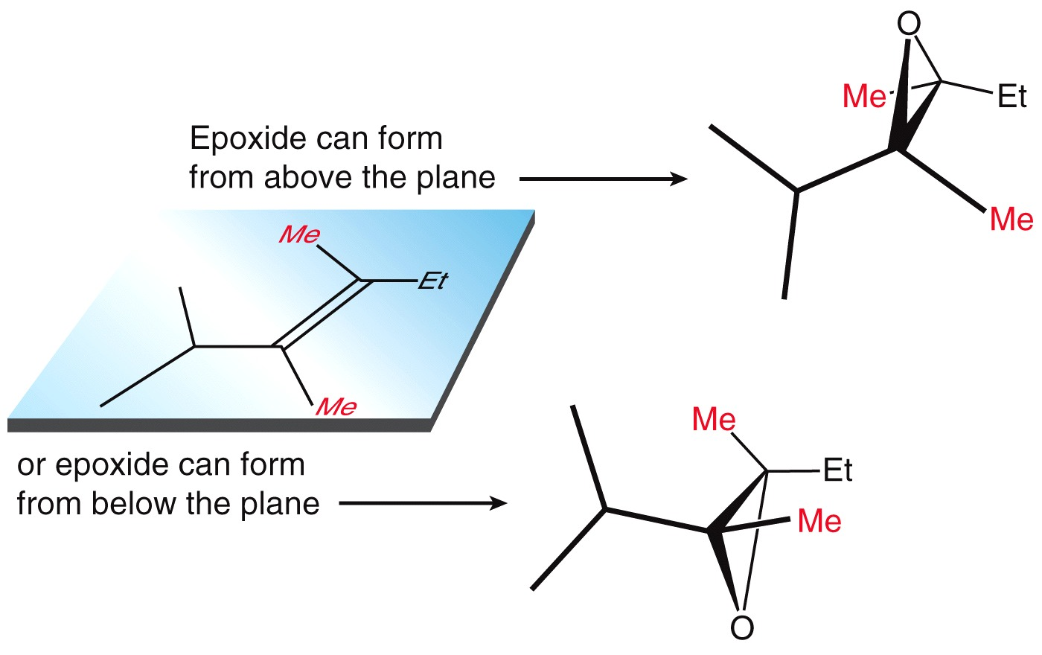
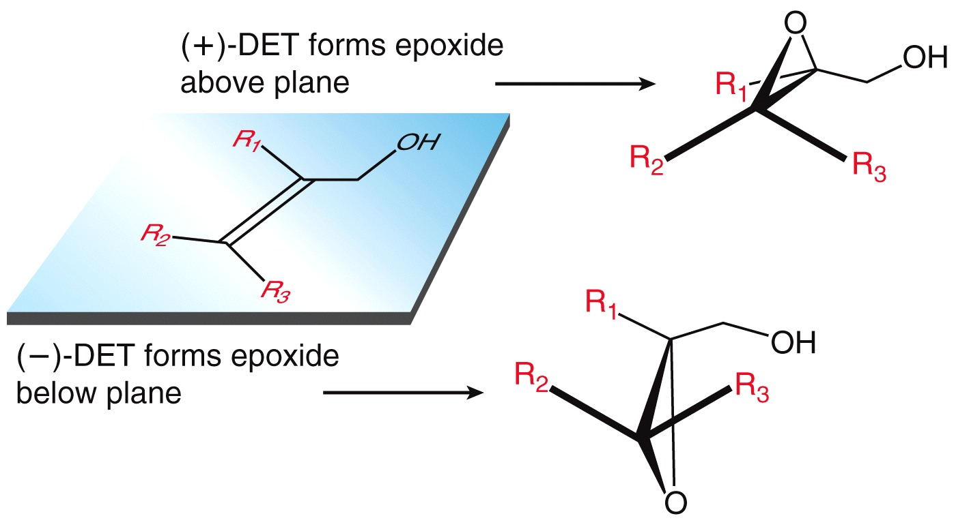
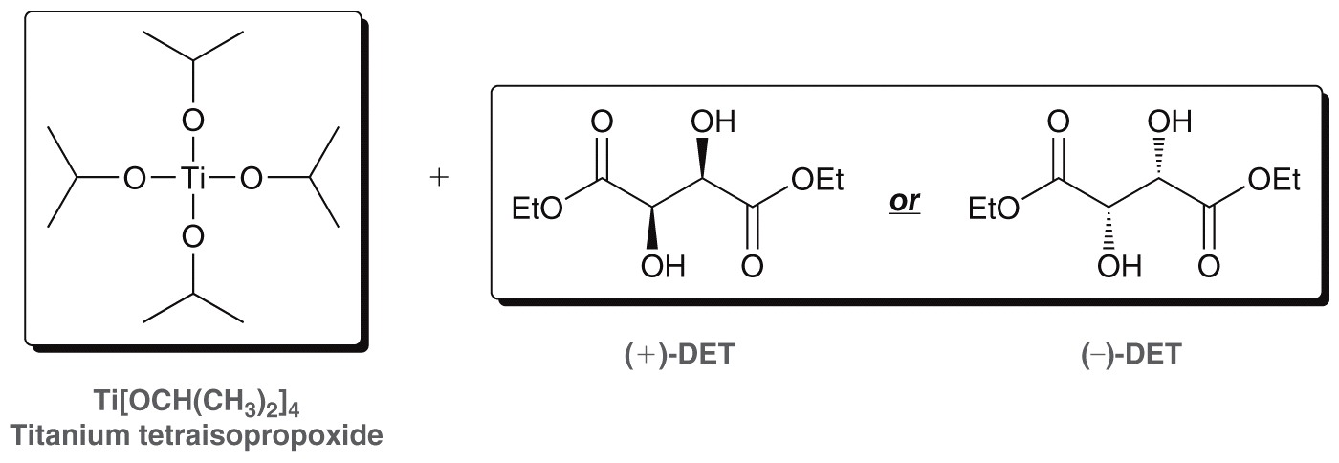
SYNTHESIS OF EPOXIDES
Peroxyacid epoxidation vs. Ti[OCH(CH₃)₂]₄

Slide 24
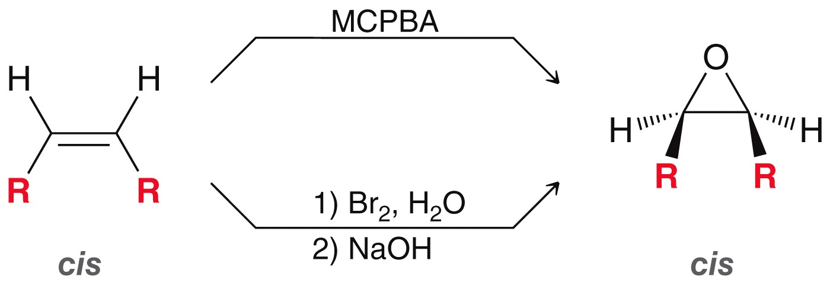
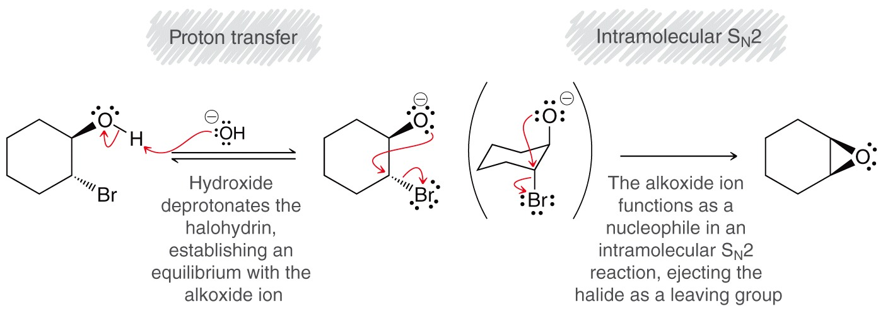
SYNTHESIS OF EPOXIDES
Cyclization of Halohydrin
This second method involves a variation of Williamson ether synthesis. If an alkoxide ion and a halogen atom are adjacent to each other in the same molecule, the alkoxide may displace the halide and form a ring.

Slide 25
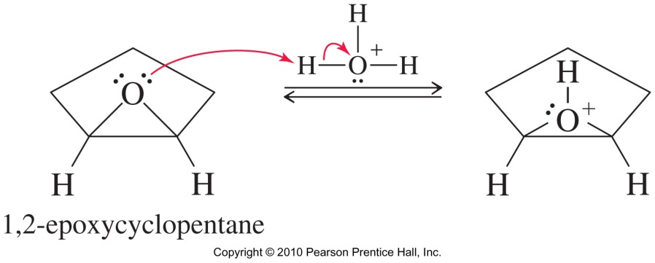
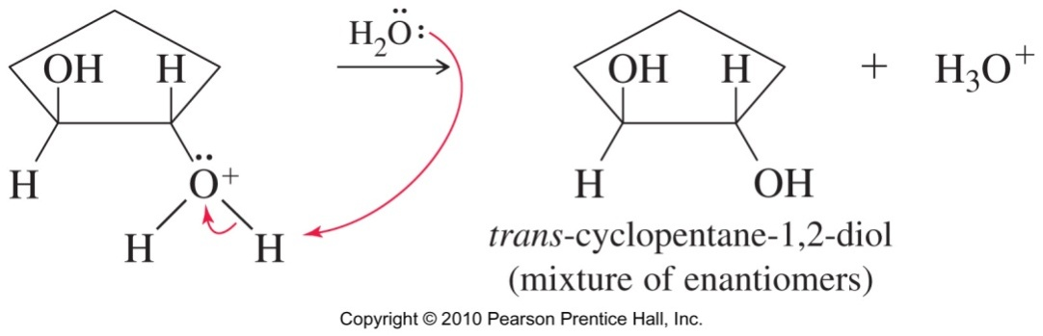
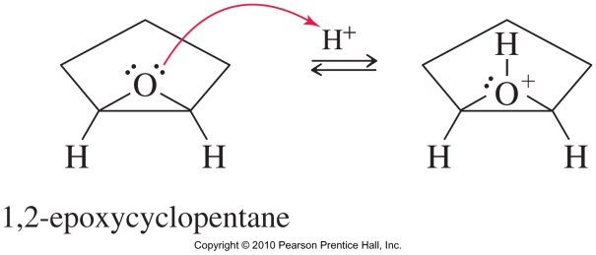
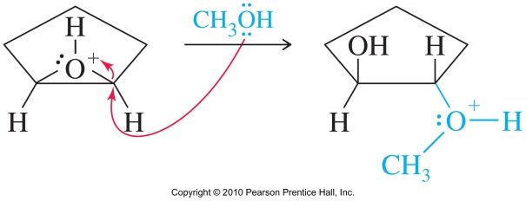
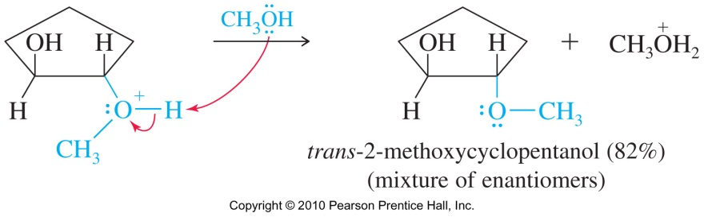
REACTION OF EPOXIDES
Ring opening in acidic conditions
Epoxides react under both acidic and basic conditions. The product of the acid-catalyzed opening depends primarily on the solvent used.
Trans diol formed in water solvent
Alkoxy alcohol formed in alcohol solvent

Slide 26
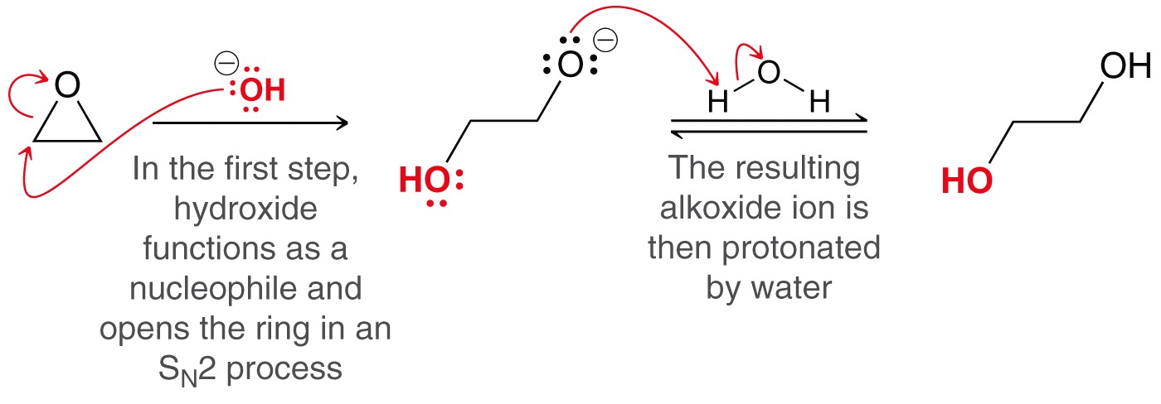
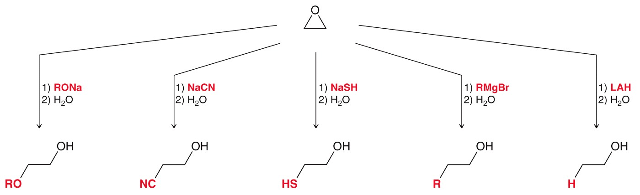
REACTION OF EPOXIDES
Ring opening in basic conditions
Strong nucleophiles react readily with epoxides
Practice 14.17 to 14.19 P. 656-657

Slide 27
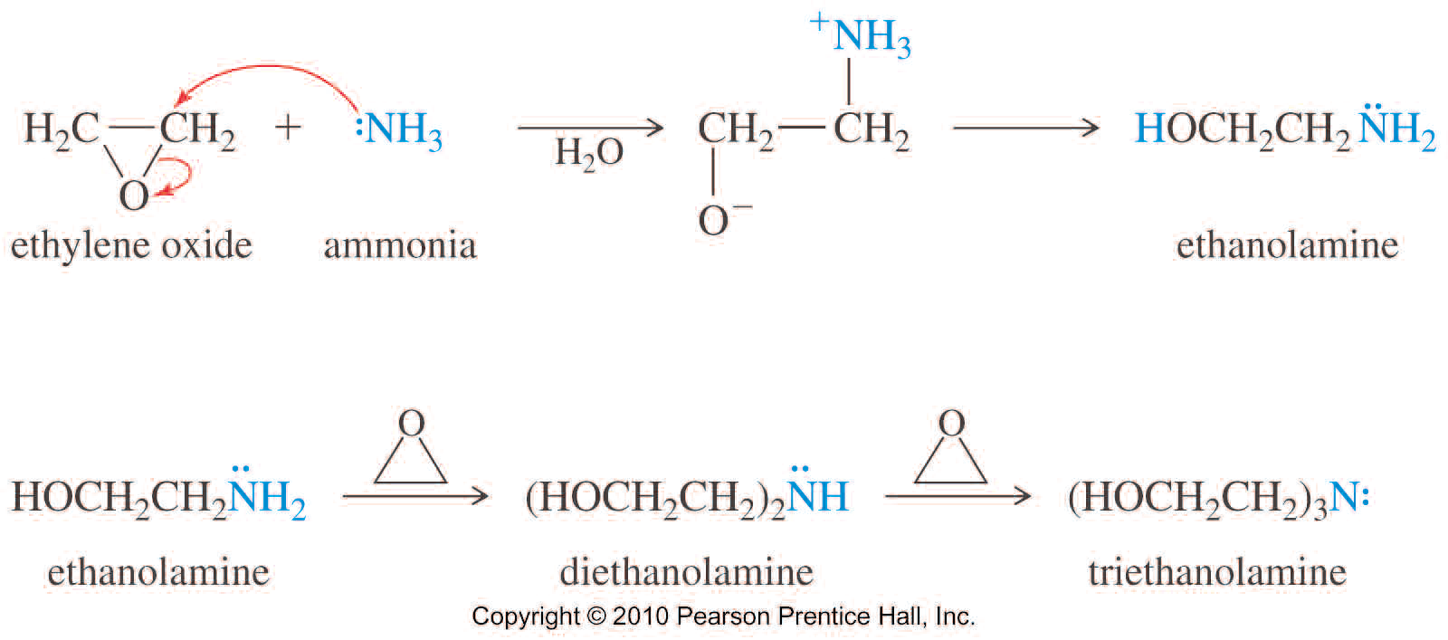
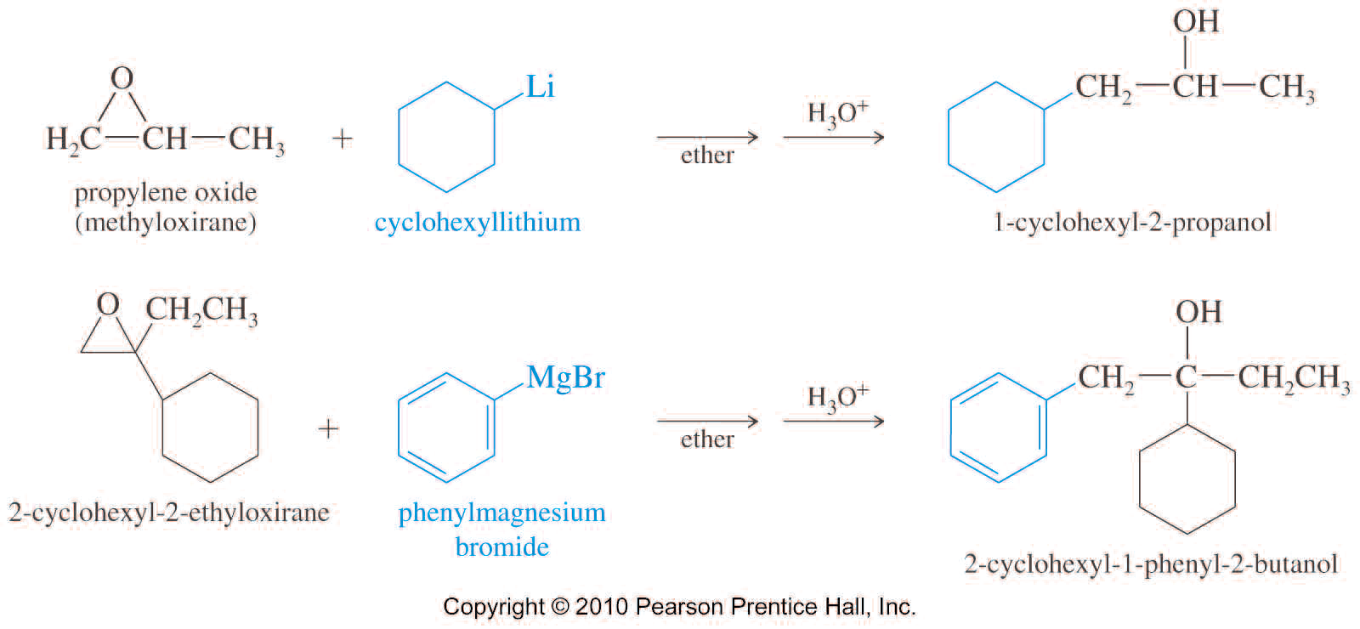
REACTION OF EPOXIDES
Reaction with Grignard and R-Li
Like other strong nucleophiles, Grignard and organolithium reagents attack epoxides to give, after hydrolysis, ring-opened alcohols.

Slide 28

REACTION OF EPOXIDES
Ring opening in base
Epoxide’s high ring strain makes it susceptible to nucleophilic attack. Either acid-catalyzed or base-catalyzed reaction may be used to open an epoxide, but the acid-catalyzed reaction takes place under milder conditions.
Unless there is an acid-sensitive functional group present, the acid-catalyzed hydrolysis is preferred.

Slide 29

REACTION OF EPOXIDES
Ring opening in base
With aqueous hydroxide, a trans 1,2-diol is formed.
With alkoxide in alcohol, a trans 1,2-alkoxy alcohol is formed.
Different products are formed in acid and base if epoxide is unsymmetrical
Orientation of epoxide opening

Slide 30



REACTION OF EPOXIDES
Biosynthesis of steroids
Practice 14.20, 14.21 P. 661

Slide 31

REACTION OF EPOXIDES
The epoxide ring opening reaction is used in industry to produce epoxy resins found in glues.
The common example is the polymer of bisphenol A and epichlorohydrin

Slide 32


Thiols and Sulfides
Sulfur appears just under oxygen on the periodic table
Sulfur appears in thiols as an –SH group analogous to the –OH group in alcohols
The name of a compound with an –SH group ends in “thiol” rather than “ol”
Thiols are also known as mercaptans. The mercaptan name comes from their ability to complex mercury
The –SH group can also be named as part of a side group rather than as part of the parent chain

Slide 33
Thiols and Sulfides
Thiols are known for their unpleasant odor:
Skunks use thiols as a defense mechanism
Methanethiol is added to natural gas (methane) so that gas leaks can be detected
The hydrosulfide ion (HS⁻) is a strong nucleophile and a weak base
HS⁻ promotes S_{N}2 rather than E2
Sulfides
Also called thioethers (R-S-R′), sulfides are sulfur analogues of ethers. Like thiols, sulfides have strong characteristic odors.
They are named like ethers, replacing “sulfide” for “ether” in common name, or “alkylthio” for “alkoxy” in IUPAC system.
Practice 14.22 P. 664

Slide 34


Thiols and Sulfides
A thiolate can attack Br₂ to produce a disulfide
Examples: Name the following compounds

Slide 35


Thiols and Sulfides
A thiolate can attack Br₂ to produce a disulfide
Disulfides can be reduced by the reverse reaction
Sulfides are generally prepared by nucleophilic attack of a thiolate on an alkyl halide

Slide 36


Thiols and Sulfides
Sulfides undergo a number of reactions including reacting with unhindered alkyl halides to give sulfonium salts.
Sulfonium salts are good alkylating agents that can add an alkyl group to a variety of nucleophiles

Slide 37


Thiols and Sulfides
Sulfides can also be oxidized
Sodium meta-periodiate can be used to form the sulfoxide
Practice 14.23 P. 667, 14.24 P. 669, 14.26 P. 671
Problems 14.30 to 14.51 P.676 to 679

Slide 38


Thiols and Sulfides
Hydrogen peroxide can be used to give the sulfone
Because sulfides are readily oxidized, they make good reducing agents

